Slide 1
Recent developments in children’s human rights –
what does this mean for social work?
Wednesday 12th June 2019
Juliet Harris, Director, Together (Scottish Alliance for Children’s Rights)
Bruce Adamson, Children and Young People’s Commissioner Scotland

Slide 2
UN Convention on the Rights of the Child (UNCRC)
“…the family, as the fundamental group of society and the natural environment for the growth and wellbeing of all its members and particularly children, should be afforded the necessary protection and assistance so that it can fully assume its responsibilities within the community…
..recognising that the child, for the full and harmonious development of his or her personality, should grow up in a family environment, in an atmosphere of happiness, love and understanding”.
UNCRC Preamble

Slide 3
What children tell us about their social workers…
“I love my social worker because she listens to me and she is very nice”
(MCP, 10)
"I like it when my social worker makes me laugh and tells me a good joke"
(MCP, 11)
"My social worker can see from my face if I am sad/ unhappy because she knows me well." (MCP, 11)
"My social worker changed everything for me by helping my Gran" (MCP, 10)
"My social worker tries to make me happy and safe and puts me and my sister before my parents" (MCP, 11)

Slide 4
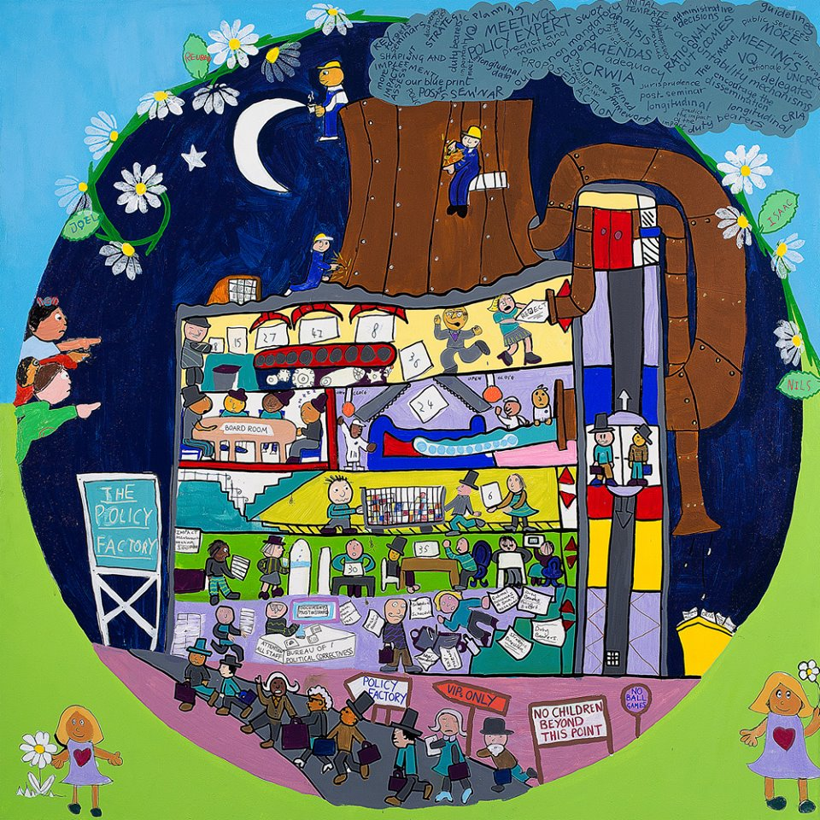
What’s happening in Scotland?
Incorporation of the UNCRC into Scots law by 2021 – placing duties on national local government to embed children’s human rights.
Care Review - identifying and delivering lasting change in the care system to transform the life chances and wellbeing of children and young people in care.
Equal Protection – a bill is progressing through Parliament to ensure children have the same level of protection from assault as adults.
Age of Criminal Responsibility – raised from 8 to 12 years old, yet still below international minimums

Slide 5
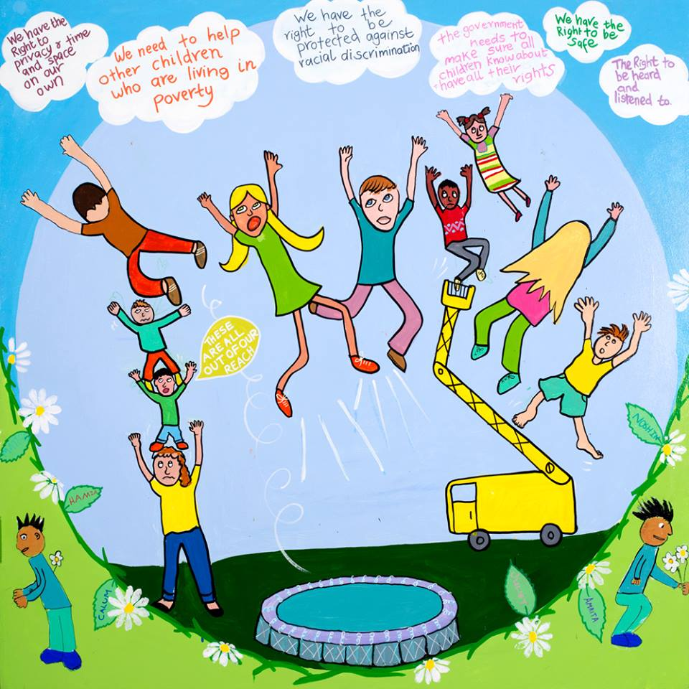
Making progress… but are children’s rights still often out of reach?

Slide 6
It’s about relationships!
"A social worker should be a good listener”
"It is good if I have time to get to know my social worker, when I can trust my social worker and they stay with me for a long time"
"I feel empowered when I know what is going on with my social worker and if I feel I can ask them questions"
"Please try to keep social workers with children as long as possible. You cannot build trusting relationships if you know they will be leaving you again soon"
"I like when my social worker sees me without other adults there"
"My social worker makes me laugh when I am upset"

Slide 8
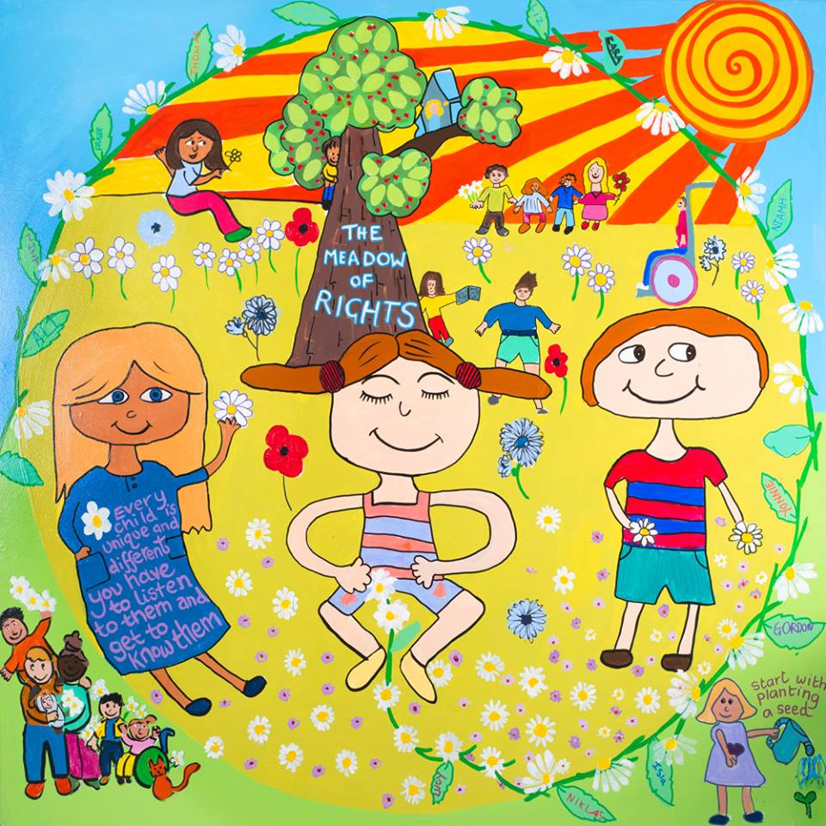
And it’s about recognition!
“Social workers sometimes make your life better by helping and making hard choices."
(MCP, 11)
"Sometimes my social worker needs to be strong as they have to make difficult decisions some people may not like or understand"
(MCP, 11)

Slide 9
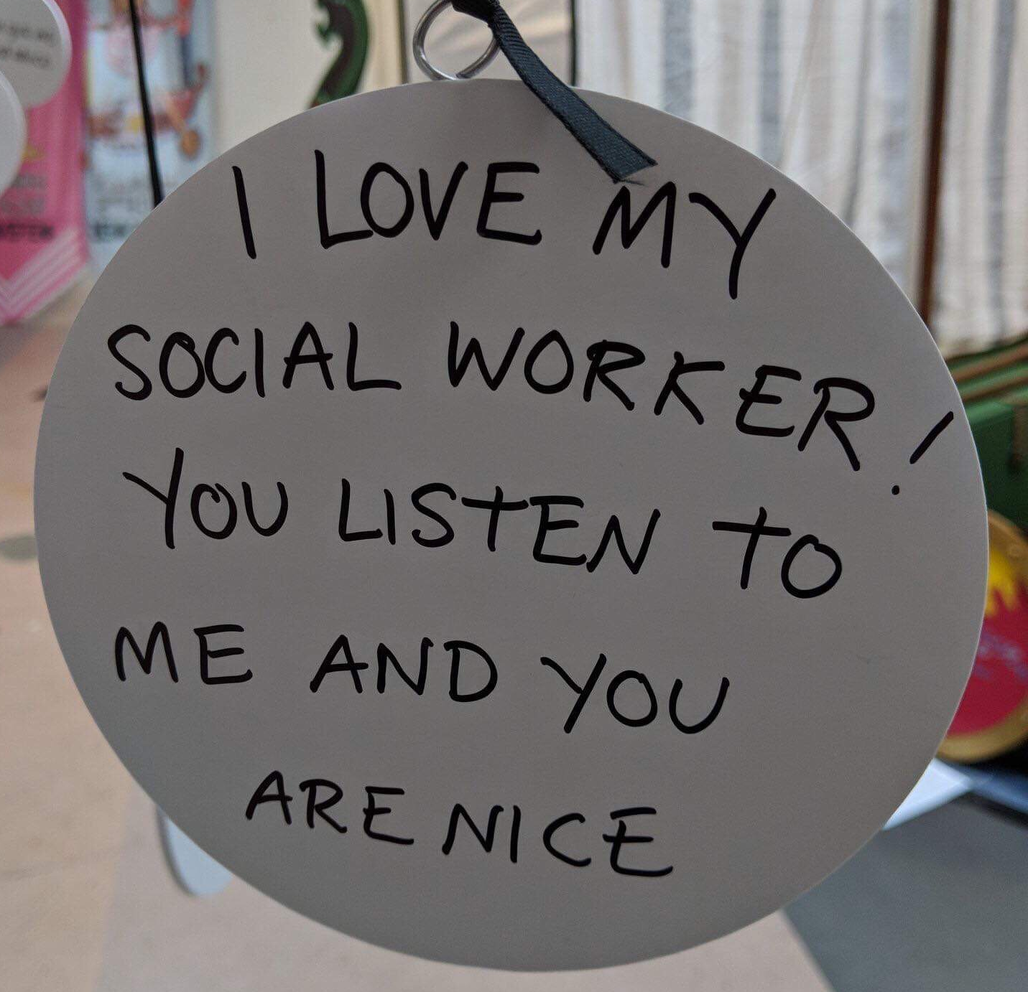

Slide 10
A final word from children…
"I think all social workers should be able to make slime with you!" (MCP, 10)

Slide 11
Recent developments in children’s human rights –
what does this mean for social work?
Wednesday 12th June 2019
Juliet Harris, Director, Together (Scottish Alliance for Children’s Rights)
Bruce Adamson, Children and Young People’s Commissioner Scotland

